Slide 2
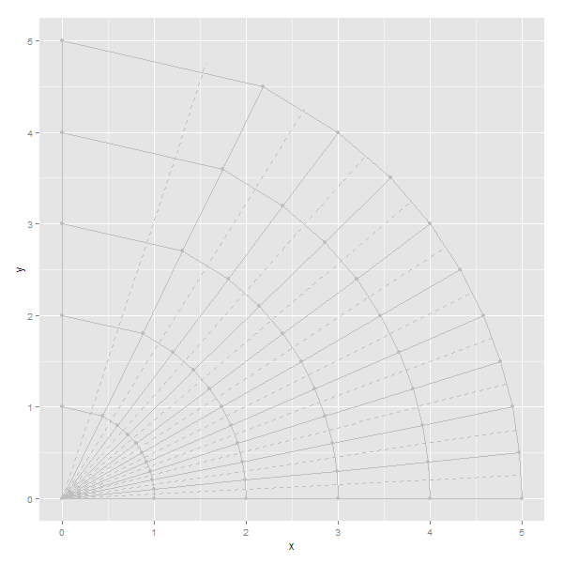
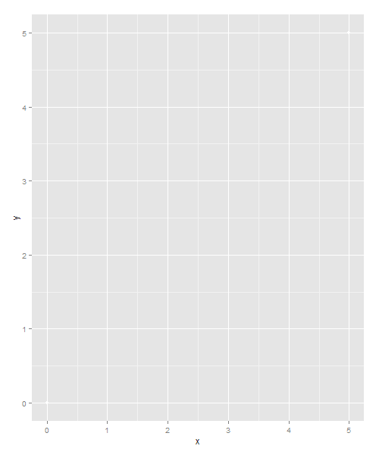
Fill
eCPM
eCPM
Fill

Slide 3
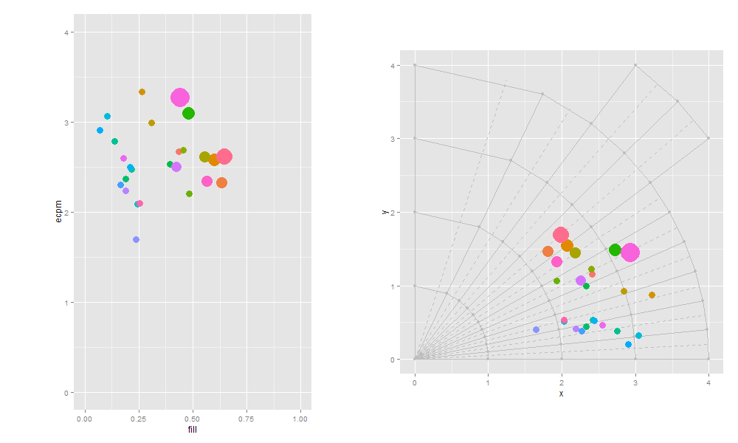
What are the 3 top chains by rCPM?
rCPM “contour lines” have the shape y=a/x

Slide 4
And now?
rCPM

Slide 5
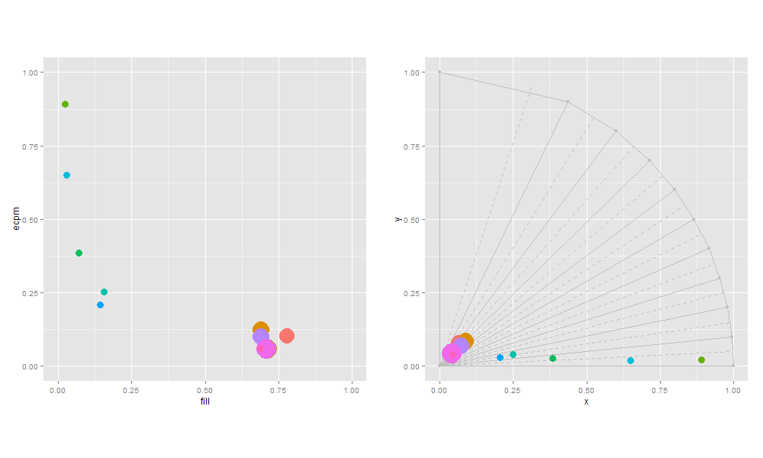

Slide 6
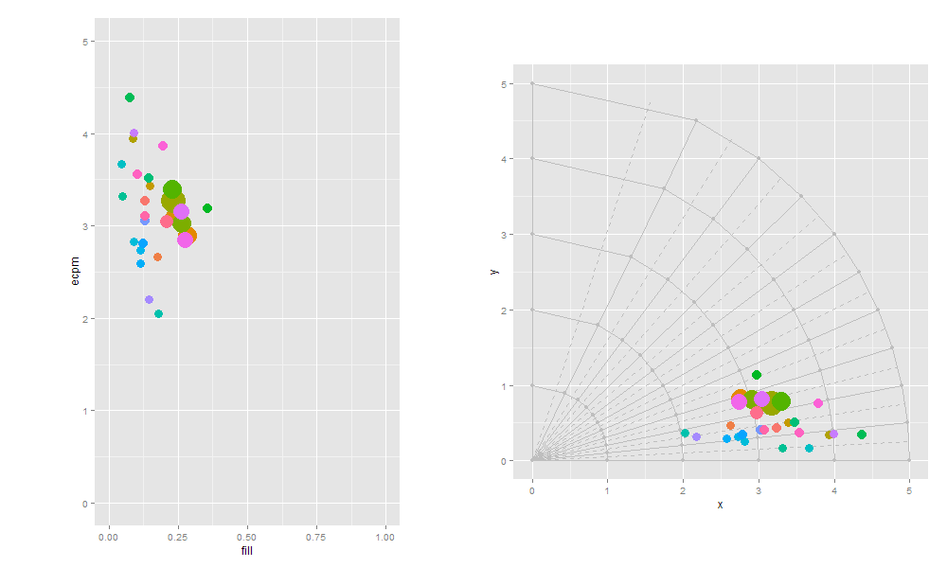

Slide 7
